Slide 1
Preparing your slide-show
Prof. Dr. John Doe, University of Montpellier

Slide 2
Example of a slide with a single content
Just use the single column template
You can enter here some text, figures, video, …

Slide 3
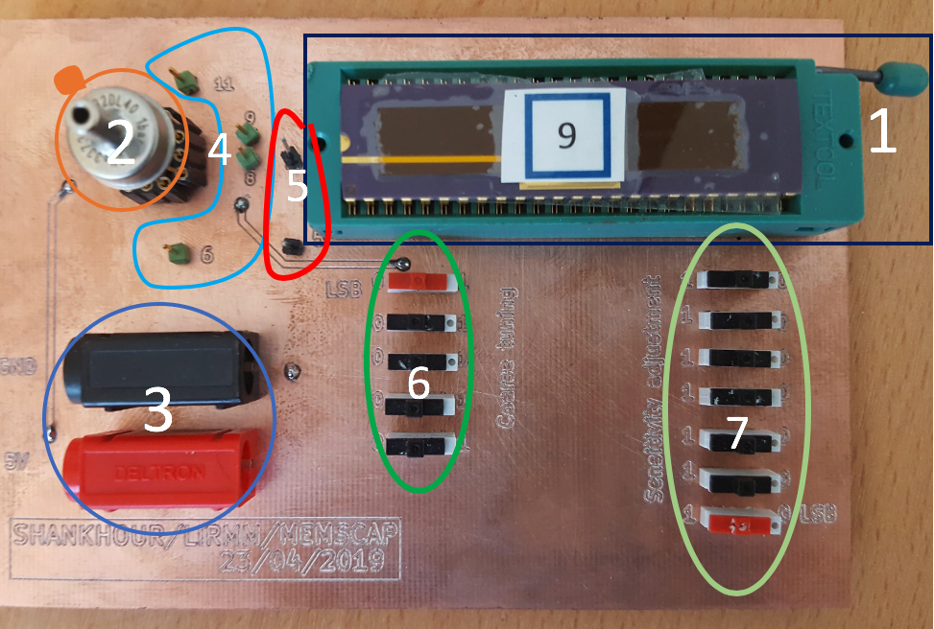
Slide with a two column format
Using the two columns template
Text on the left side
Illustration on the right side

Slide 4
Title only slide to customize your slide with whatever you may want!

